Slide 1
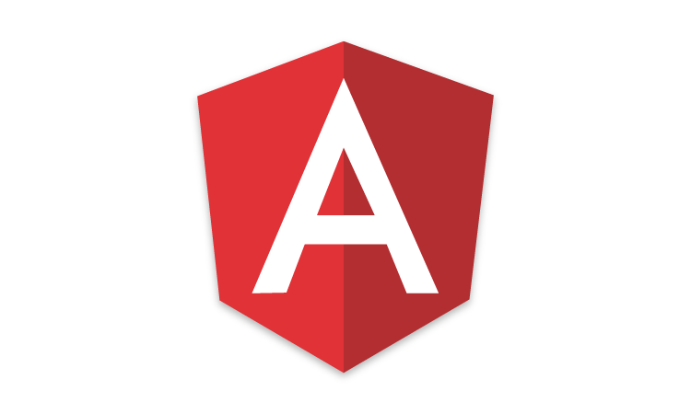



Angular JS
#1 – HELLO WORLD
/ VMCREATIONSBLOG
VM Creations
Technology.vishalsrini.com

Slide 2
Why JavaScript Frameworks?
Complexity of managing DOM manipulation and data updates manually
Well defined application architectures:
  Model View Controller / Model View View Model / Model View Whatever
  Binding of model and view: controllers, view models
XBBLWSQ
VISHAL S

Slide 3
Software Library
Collection of implementations of behavior with a well-defined interface by which the behavior is invoked
Reuse of behavior
Modularity
E.g., jQuery
XBBLWSQ
VISHAL S

Slide 4
Software Framework
Abstraction in which software provides generic functionality that can be selectively changed by additional user-written code
Universal, reusable environment that provides particular functionality as part of a larger software platform
E.g., Angular, Ember, Backbone
XBBLWSQ
VISHAL S

Slide 5
JavaScript Frameworks
Angular • Meteor
Ember • Polymer
Backbone • Knockout
React • Vue
Aurelia • Mercury
XBBLWSQ
VISHAL S

Slide 6


JavaScript Frameworks
Learning
curve
Opinionated
Ease of Use
XBBLWSQ
VISHAL S

Slide 7
What is Angular?
Structural framework for dynamic web applications
  HTML only does static documents
  Angular fills in the gap to support dynamic applications
    Solving the impedance mismatch
    Designed with CRUD applications (data-driven) in mind
    Declarative approach
XBBLWSQ
VISHAL S

Slide 8
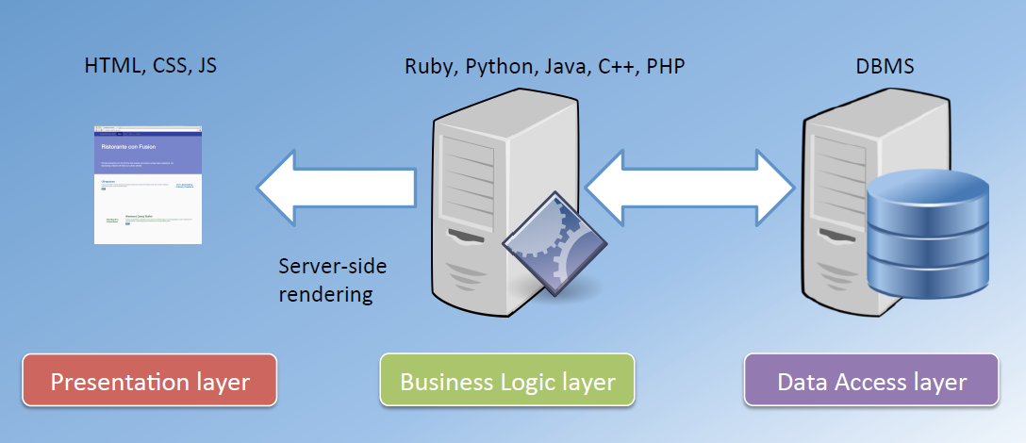
Traditional web development
XBBLWSQ
VISHAL S

Slide 9
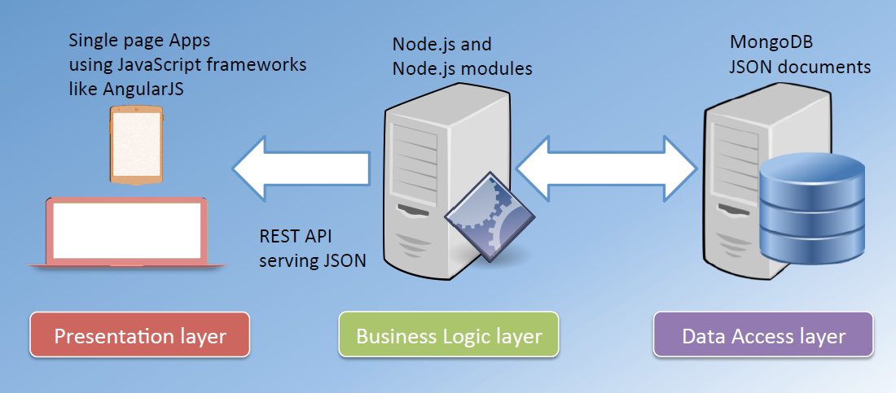
Modern web development
XBBLWSQ
VISHAL S

Slide 10
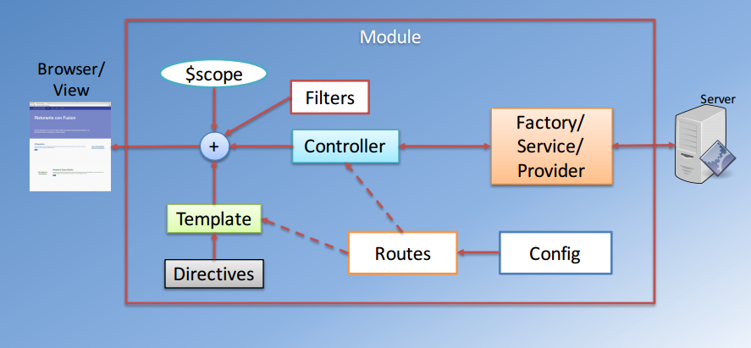
Angular Overview
XBBLWSQ
VISHAL S

Slide 11
Angular Vocabulary
Concept | Description
Template | HTML with additional markup
Directives | extend HTML with custom attributes and elements
Model | the data shown to the user in the view and with which the user interacts
Scope | context where the model is stored so that controllers, directives and expressions can access it
Expressions | access variables and functions from the scope
Compiler | parses the template and instantiates directives and expressions
Filter | formats the value of an expression for display to the user
View | what the user sees (the DOM)
Data Binding | sync data between the model and the view
Controller | the business logic behind views
Dependency Injection | Creates and wires objects and functions
Injector | dependency injection container
Module | a container for the different parts of an app including controllers, services, filters, directives which configures the Injector
Service | reusable business logic independent of views

Slide 12
Getting Started
Include the Angular JS code. Two ways to do it
  One way: Download the Java script and give the reference of it
  Example:
  Another way: Use the CDN (Content Delivery Network) to get dependencies during rendering
    Example:
  <script type="text/javascript" src=“script/angularjs.js”></script>
  <script type="text/javascript" src="https://ajax.googleapis.com/ajax/libs/angularjs/1.4.8/angular.min.js"></script>
XBBLWSQ
VISHAL S

Slide 13
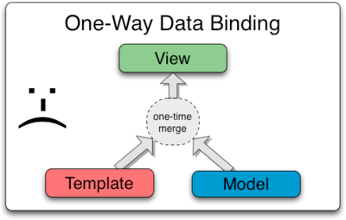
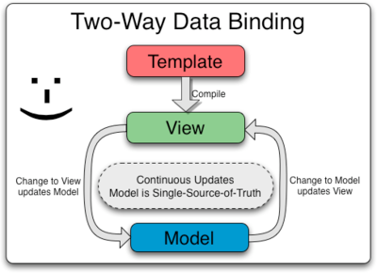
Classic vs Angular
Classic Framework
Angular Framework
XBBLWSQ
VISHAL S

Slide 14
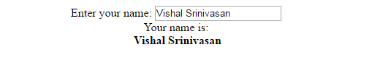
Simple Example
  <body style="text-align: center" ng-app>
  Enter your name: <input type="text" ng-model="name" /> <br/>
  Your name is: <br/> <b> {{name}} </b>
  </body>
OUTPUT
LIVE DEMO
XBBLWSQ
VISHAL S

Slide 15



Basic Controller
  <div ng-app="myApp" ng-controller="HelloController">
  {{ greeting }}
  </div>
  <script src="controller.js"></script>
HTML
  var myApp = angular.module('myApp',[]);
  myApp.controller('HelloController', ['$scope', function($scope) {
  $scope.greeting = 'Hello World!!';
  }]);
JS
LIVE DEMO
XBBLWSQ
VISHAL S

Slide 16
What are Scopes?
It is an object that refers to the application model.
It is an execution context for expressions
Scopes are arranged in hierarchical structure which mimic the DOM structure of the application. Scopes can watch expressions and propagate events
  NOTE
  Scope is the glue between application controller and the view. During the template linking phase the directives set up $watch expressions on the scope. The $watch allows the directives to be notified of property changes, which allows the directive to render the updated value to the DOM.
XBBLWSQ
VISHAL S

Slide 17


Root Scope Example
HTML
  <div ng-app=“myApp” class="show-scope-demo">
  <div ng-controller="GreetController"> Hello {{name}}! </div>
  <div ng-controller="ListController">
  <ol><li ng-repeat="name in names">{{name}} from {{department}}</li></ol>
  </div>
  </div>
  myApp.controller('GreetController', ['$scope', '$rootScope', function($scope, $rootScope) {
  $scope.name = 'World';
  $rootScope.department = 'Angular';
  }])
  .controller('ListController', ['$scope', function($scope) {
  $scope.names = ['Vishal', 'Ram', 'Sedhu'];}]);
JS
  OUTPUT DEMO
XBBLWSQ
VISHAL S

Slide 18
Dependency Injection
Dependency Injection (DI) is a software design pattern that deals with how components get hold of their dependencies
Angular invokes certain functions via the injector. You need to annotate these functions so that the injector knows what services to inject into the function
There are three ways of annotating your code with service name information
  Using the inline array annotation (preferred)
  Using the $inject property annotation
  Implicitly from the function parameter names (has caveats)
XBBLWSQ
VISHAL S

Slide 19
Inline Array Annotation
This is the preferred way to annotate application components
Example
  myApp.controller('GreetController', ['$scope', '$rootScope', function($scope, $rootScope) {
  ….
  ….
  }]);
  NOTE
  When using this type of annotation, take care to keep the annotation array in sync with the parameters in the function declaration.
XBBLWSQ
VISHAL S

Slide 20
$inject Property Annotation
To allow the minifiers to rename the function parameters and still be able to inject the right services, the function needs to be annotated with the $inject property
  var MyController = function($scope, greeter) {
  // ...
  }
  MyController.$inject = ['$scope', 'greeter'];
  someModule.controller('MyController', MyController);
  NOTE
  When using this type of annotation, take care to keep the annotation array in sync with the parameters in the function declaration. (similar to previous)
XBBLWSQ
VISHAL S

Slide 21
Implicit Annotation
The simplest way to get hold of the dependencies is to assume that the function parameter names are the names of the dependencies
  someModule.controller('MyController', function($scope, greeter) {
  // ...
  });
  NOTE
  This method will not work with JavaScript minifiers/obfuscators because of how they rename parameters. Tools like ng-annotate let you use implicit dependency annotations in your app and automatically add inline array annotations prior to minifying. If you decide to take this approach, you probably want to use ng-strict-di. Because of these caveats, it is better to avoid this style of annotation.
XBBLWSQ
VISHAL S

Slide 22
Filters
A filter formats the value of an expression for display to the user. They can be used in view templates, controllers or services and it is easy to define your own filter
Default Filter
Chaining of Filters
  Syntax:
  {{ expression | filter }}
  {{ expression | filter1 | filter2 | ... }}
  {{ expression | filter:argument1:argument2:... }}
Filter with more args
XBBLWSQ
VISHAL S

Slide 23
Inbuilt Filters
String Manipulation
  {{ variable | uppercase }}
  {{ variable | lowercase }}
Number Manipulation
  {{ defaultNumber | number }}
  {{ defaultNumber | number:4 }}
  {{ defaultNumber | currency }}
  {{ defaultNumber | currency:'$VISHAL' }}
  {{ defaultNumber | currency:'£':0 }}
Date and Time Manipulation
  {{ dateCommon | date }}
  {{ dateCommon | date:'yyyy' }}
JSON
  {{ userInfo | json }}
XBBLWSQ
VISHAL S

Slide 24
Custom Filters
Just register a new filter factory function with your module. This factory function should return a new filter function which takes the input value as the first argument. Any filter arguments are passed in as additional arguments to the filter function.
  Syntax:
  angular.module('myApp', [])
  .filter(‘<FilterName>', function() {
  return function(input) {
  // …
  };
  })
XBBLWSQ
VISHAL S

Slide 25
Custom Filters
Example:
  myApp.filter('reverse', function() {
  return function(input, uppercase) {
  input = input || '';
  var out = "";
  for (var i = 0; i < input.length; i++) {
  out = input.charAt(i) + out; }
  if (uppercase) {
  out = out.toUpperCase(); }
  return out; }; });
  myApp.controller('MyController', ['$scope', 'reverseFilter', function($scope, reverseFilter) {
  $scope.greeting = 'vishal';
  $scope.filteredGreeting = reverseFilter($scope.greeting);
  }]);
  OUTPUT DEMO
XBBLWSQ
VISHAL S

Slide 26
Routing
It is recommended to develop AngularJS applications as a hierarchy of Components. Each Component is an isolated part of the application, which is responsible for its own user interface and has a well defined programmatic interface to the Component that contains it
It is the main component which a single page application mostly need
XBBLWSQ
VISHAL S

Slide 27


Routing
Example:
  var myApp=angular.module(‘myApp', ['ngRoute']);
  //configure our routes
  myApp.config(function ($routeProvider) {
  $routeProvider.
  when('/', {
  templateUrl: 'pages/ruleSetCreation.html',
  controller: 'AppCtrl'
  }).
  when('/edit', {
  templateUrl: 'pages/ruleSetEdit.html',
  controller: 'ruleSetEditCtrl'
  }).
  when('/view', {
  templateUrl: 'pages/ruleSetView.html',
  controller: 'ruleSetViewCtrl'
  }); });
JS
XBBLWSQ
VISHAL S

Slide 28
Still more concepts
Custom Directives
To route using states ($state.go) instead of urlRouteProvider ($StateProvider)
Iterating over Array of elements using ng-repeat
Creating separate component
Yomen generator using npm for structured development
Testing your code using KARMA, JASMINE, PROTRACTOR test cases
XBBLWSQ
VISHAL S

Slide 29
Best Learning Places
Edit your code in PLUNKER (www.plnkr.co)
Use of PLURALSIGHT
Use plugins for eclipse or use brackets/sublime which has predefined plugins and interactive usage
XBBLWSQ
VISHAL S

Slide 30


XBBLWSQ
VISHAL S

